Slide 1
CENTRUM KSZTAŁCENIA ZAWODOWEG I USTAWICZNEGO W SOSNOWCU
EDUCATIONAL INSTITUTION OF VOCATIONAL AND LIFELONG TRAINING IN SOSNOWIEC - TECHNICAL SCHOOL NUMBER 7
OF DESIGN AND CLOTHES STYLING

Slide 2
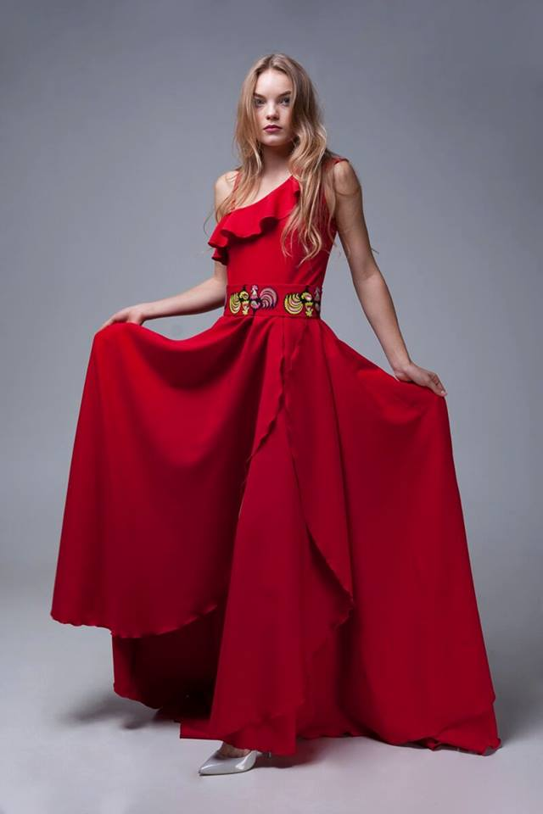
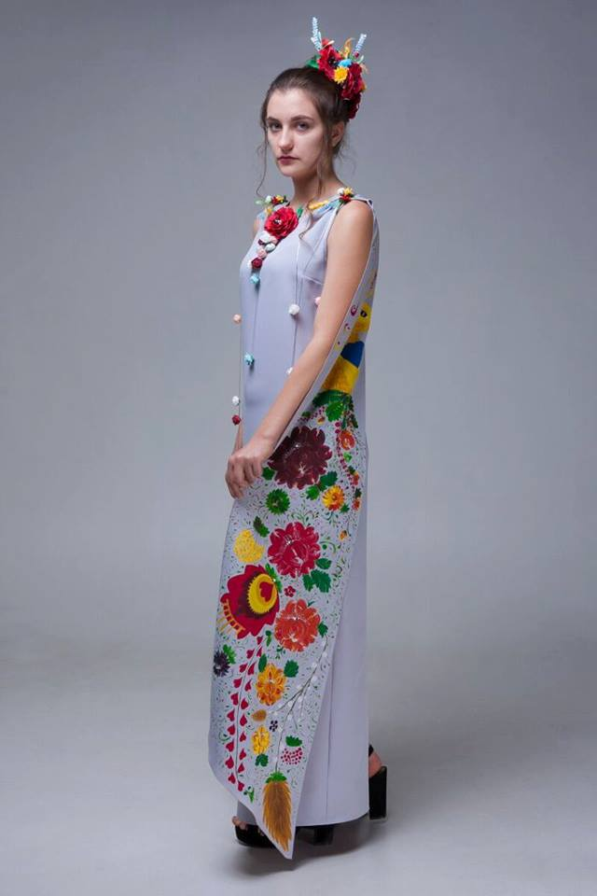
VOCATIONAL SUBJECTS FOR FASHION TECHNICIAN- THEORETICAL TRAINING

Slide 3
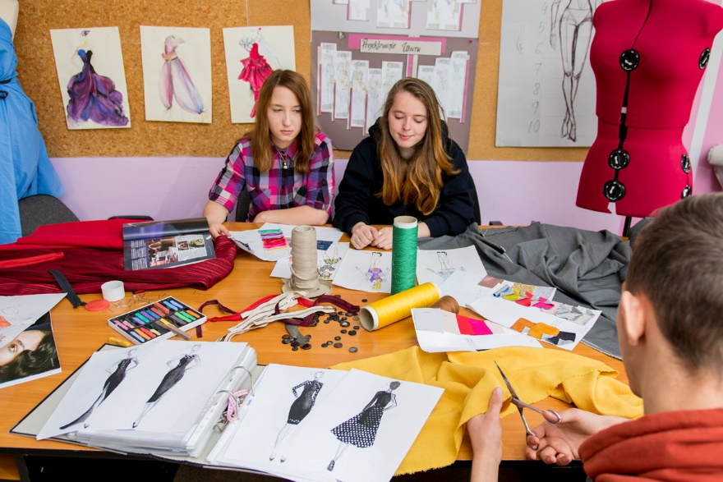
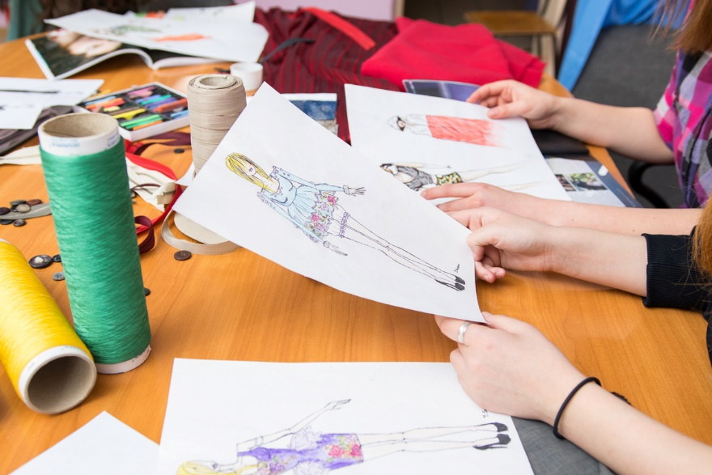
CLOTHES DESIGN AND STYLING
students analyse trends in fashion, recognize target groups of customers

Slide 4
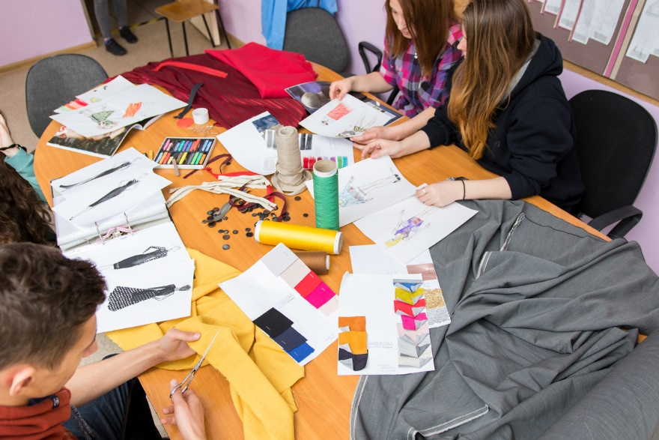
CLOTHING MATERIALS SCIENCE
students distinguish between textile raw materials and determine their properties and applications

Slide 5
GARMENT MANUFACTURING TECHNOLOGY
students define the rules for work in cutting and sewing rooms, defines the rules for the operation of machinery and equipment used in the manufacture of garments; use software supporting the performance of tasks

Slide 6
CONSTRUCTION AND MODELLING OF GARMENTS
students use designs, forms, templates of garments, perform sewing measurement, select clothing materials, sewing and decorative accessories to the assortment of clothing, apply the principles of construction and modelling of forms of garments (top/bottom parts)- skirts, trousers, blouses, jackets

Slide 7
FASHION MARKETING
students know how to organize activities connected with launching, advertising, displaying garments, how to boost sales, how to undertake joint activities with other entrepreneurs

Slide 8
BUSINESS ACTIVITY IN FASHION INDUSTRY
students apply concepts related to the functioning of the market economy, apply labour law, legal provisions on the protection of personal data and tax law and copyright law regulations, prepare documentation necessary to take up and pursue a business activity, are skilled at business correspondence

Slide 9
PROFESSIONAL FOREIGN LANGUAGE- ENGLISH FOR FASHION INDUSTRY
students use English specific for fashion industry- kinds of textiles, equipment, machines, accessories. They can name fashion industry jobs. They can interact with a foreign employer or client. They can perform business tasks in English.

Slide 10
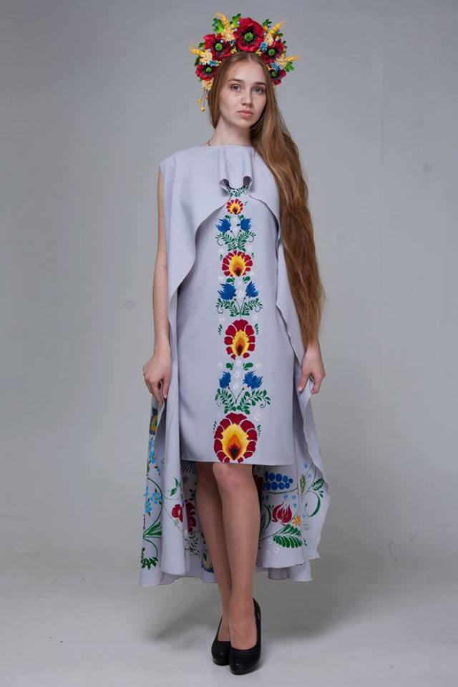
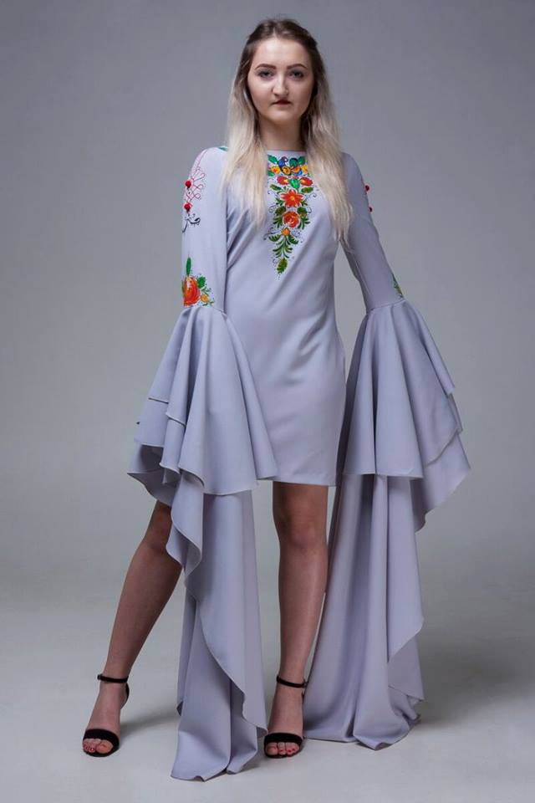
SUBJECTS FOR FASHION TECHNICIAN- PRACTICAL TRAINING

Slide 11
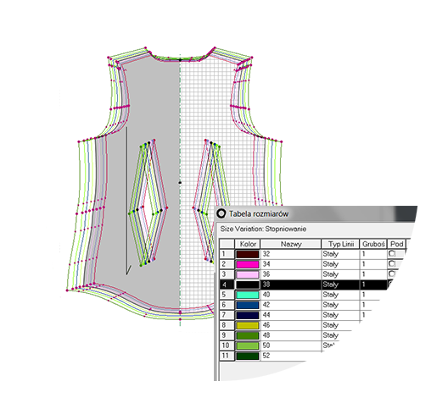
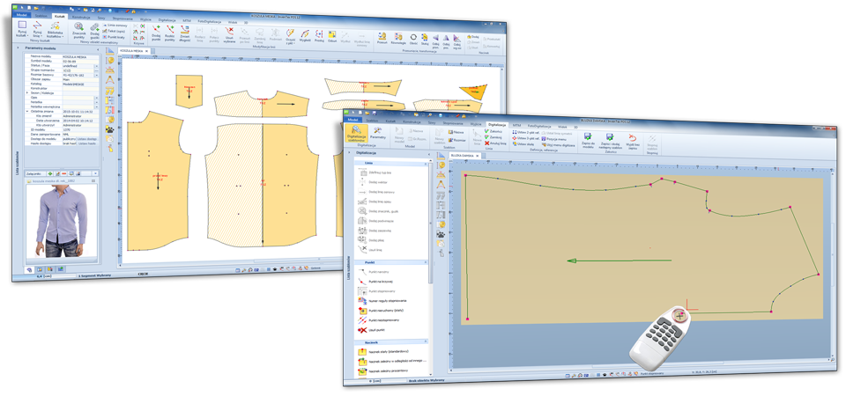
GARMENT MANUFACTURING PROCESSES ORGANIZATION
students take into account current fashion trends in the garment design processes, prepare garment documentation, assess the quality of clothing materials before cutting, prepare cutting layouts and templates with the application of computer software, organize the work in the cutting room, selects machines and equipment

Slide 12
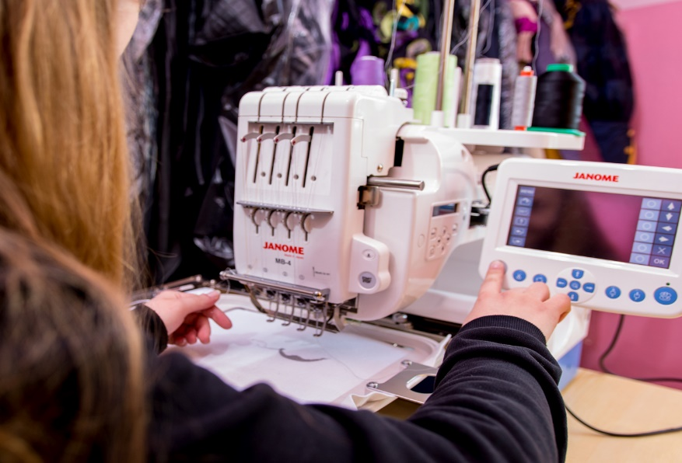
MANUFACTURE OF GARMENTS
students use a documentation relating to garments, calculate the consumption of clothing materials and sewing accessories, cut clothing materials, select machinery and equipment for the manufacture of specific garments, operate sewing machines

Slide 13
ON-THE-JOB TRAINING (DIRECT INSTRUCTION) AT POTENTIAL EMPLOYERS';
THE TOTAL OF 160 HOURS (4 WEEKS)

Slide 14
CKZiU STUDENTS KNOW:
HOW TO DESIGN, MANUFACTURE, STYLE GARMENTS
PREPARE GARMENT- RELATED DOCUMENTS
OPERATE MACHINES, USE NECESSARY EQUIPMENT, ACCESSORIES
ORGANIZE AND CONTROL MANUFACTURING PROCESSESSET UP AND RUN BUSINESS ACTIVITY, ORGANIZE ACTIVITIES CONNECTED WITH FASHION MARKETING

Slide 15
THANK YOU FOR YOUR ATTENTION

Slide 16
Contact:
Centrum Kształcenia Zawodowego i Ustawicznego w Sosnowcu
ul. Grota Roweckiego 64
sekretariat@ckziu.com
EDYTA CYGANEK-
THE HEAD OF STUDENTS' PRACTICAL TRAINING DEPARTMENT
AGNIESZKA GALICKA -AN ENGLISH TEACHER

